Slide 1
AI Study Group
Hands-on Machine Learning with Sci-kit-Learn, Keras & Tensorflow, Géron, 3rd Edition, Chapter 19 Discussion
May 29, 2024

Slide 2
Chapter 19: Training and Deploying Tensorflow Models
Tensorflow Serving
Vertex AI
GPU Considerations
Other Vertex AI Considerations
Final Thoughts on the Book

Slide 3
A. Tensorflow Serving
A serving system is a software infrastructure designed to deploy, manage, and serve machine learning models in production environments. The primary purpose of a serving system is to make trained models available for use by applications and end-users, allowing them to generate predictions or inferences in real-time or batch model.
TensorFlow Serving (TS) is a serving system written in C++ and designed for machine learning models. Developed by Google, it also supports serving models trained with other machine learning frameworks. It is a “wrapper” for models ready to be deployed.

Slide 4
A. Tensorflow Serving
TS supports versioned models, allowing updates and rollbacks. It can deploy new versions of models without downtime.
TS provides both REST API and gRPC interfaces, making it easy to integrate with different client applications. A REST API is an API that uses standard HTTP verbs such as GET, POST, PUT and DELETE, and uses JSON as inputs and outputs. The gRPC protocol is more complex but more efficient – data is exchanged using protocol buffers.
TS is widely used for deploying machine learning models in production due to its robustness and ease of integration with the TensorFlow ecosystem.

Slide 5
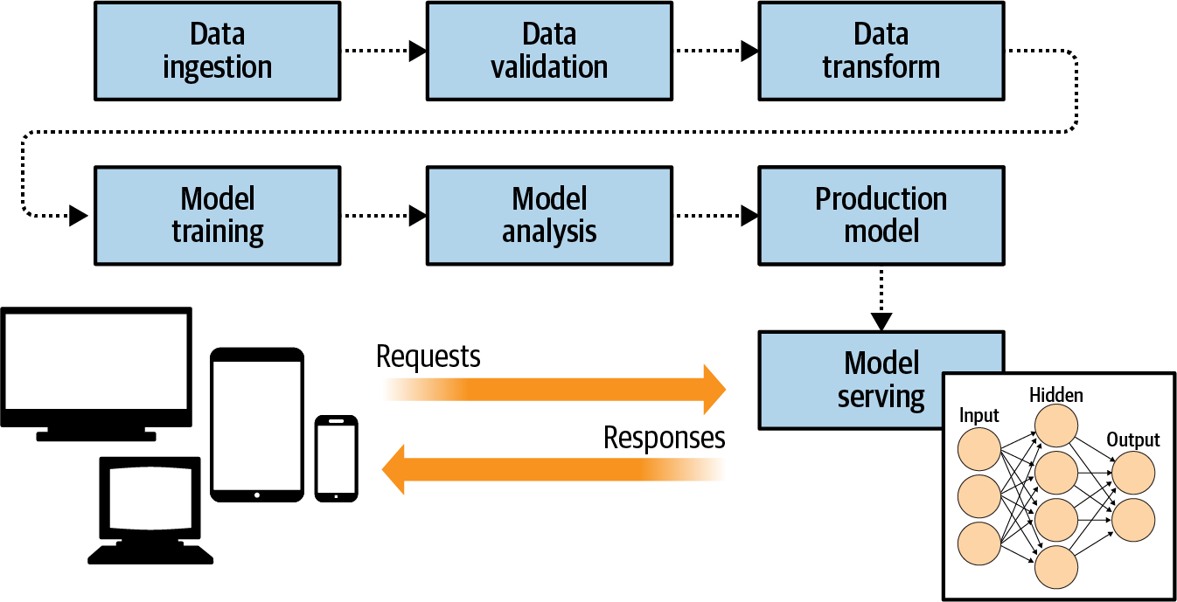
Tensorflow Serving (Moroney, AI and Machine Learning for Coders)

Slide 6
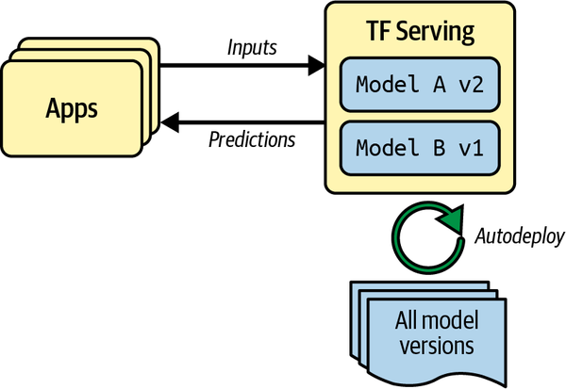
Tensorflow Serving (Géron, Figure 19-1)

Slide 7
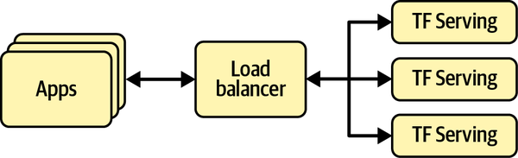
Scaling up TF Serving with Load Balancing (Géron, Figure 19-2)

Slide 8
A. Tensorflow Serving - Implementation
TS can be implemented in a variety of ways:
System’s package manager
Docker image/container
Installing from the source
TS can be implemented in Ubuntu with the following steps:
Install the tensorflow-model-server package.
Save the absolute path of the base model directory.
Start the server.

Slide 9
A. Tensorflow Serving - Code
Install the tensorflow-model-server package (running on Colab):
if "google.colab" in sys.modules or "kaggle_secrets" in sys.modules:
url = "https://storage.googleapis.com/tensorflow-serving-apt"
src = "stable tensorflow-model-server tensorflow-model-server-universal"
!echo 'deb {url} {src}' > /etc/apt/sources.list.d/tensorflow-serving.list
!curl '{url}/tensorflow-serving.release.pub.gpg' | apt-key add -
!apt update -q && apt-get install -y tensorflow-model-server
%pip install -q -U tensorflow-serving-api
2. Save the absolute path of the base model directory:
import os
os.environ["MODEL_DIR"] = str(model_path.parent.absolute())

Slide 10
A. Tensorflow Serving - Code
3. Start the server.
%%bash --bg
tensorflow_model_server \
--port=8500 \
--rest_api_port=8501 \
--model_name=my_mnist_model \
--model_base_path="${MODEL_DIR}" >my_server.log 2>&1

Slide 11
B. Google Vertex AI
Google's Vertex AI is a managed machine learning platform designed to build, deploy, and scale machine learning models. It provides a unified environment that integrates Google's machine learning tools and services, simplifying the end-to-end process of developing and managing machine learning workflows.
Vertex AI simplifies the deployment and management of models, supporting versioning, monitoring, and scaling to ensure reliable and efficient operation in production environments.
By providing these comprehensive features, Vertex AI helps organizations streamline their machine learning workflows, from data preparation and model training to deployment and monitoring, enhancing productivity and accelerating time to value.

Slide 12
B. Vertex AI - Implementation
Vertex AI can be implemented as follows:
Authenticate to use Google Cloud Service (Vertex AI).
Create a Google Cloud Storage bucket to store the SavedModel.
Upload the model directory to the bucket.
Tell Vertex AI about the model.
Create an endpoint and deploy the model in Vertex AI.

Slide 13
B. Vertex AI - Code
Authenticate to use Google Cloud Service (Vertex AI).
project_id = "my_project" ##### CHANGE THIS TO YOUR PROJECT ID #####
if "google.colab" in sys.modules:
from google.colab import auth
auth.authenticate_user()
elif "kaggle_secrets" in sys.modules:
from kaggle_secrets import UserSecretsClient
UserSecretsClient().set_gcloud_credentials(project=project_id)
else:
os.environ["GOOGLE_APPLICATION_CREDENTIALS"] = "my_service_account_key.json"

Slide 14
B. Vertex AI - Code
Create a Google Cloud Storage bucket to store the SavedModel.
from google.cloud import storage
bucket_name = "my_bucket" ##### CHANGE THIS TO A UNIQUE BUCKET NAME #####
location = "us-central1"
storage_client = storage.Client(project=project_id)
bucket = storage_client.create_bucket(bucket_name, location=location)
#bucket = storage_client.bucket(bucket_name) # to reuse a bucket instead

Slide 15
B. Vertex AI - Code
Upload the model directory to the bucket.
def upload_directory(bucket, dirpath):
dirpath = Path(dirpath)
for filepath in dirpath.glob("**/*"):
if filepath.is_file():
blob = bucket.blob(filepath.relative_to(dirpath.parent).as_posix())
blob.upload_from_filename(filepath)
upload_directory(bucket, "my_mnist_model")

Slide 16
B. Vertex AI - Code
Tell Vertex AI about the model.
from google.cloud import aiplatform
server_image = "gcr.io/cloud-aiplatform/prediction/tf2-gpu.2-8:latest"
aiplatform.init(project=project_id, location=location)
mnist_model = aiplatform.Model.upload(
display_name="mnist",
artifact_uri=f"gs://{bucket_name}/my_mnist_model/0001",
serving_container_image_uri=server_image,
)

Slide 17
B. Vertex AI - Code
Create an endpoint and deploy the model in Vertex AI.
endpoint = aiplatform.Endpoint.create(display_name="mnist-endpoint")
endpoint.deploy(
mnist_model,
min_replica_count=1,
max_replica_count=5,
machine_type="n1-standard-4",
accelerator_type="NVIDIA_TESLA_K80",
accelerator_count=1
)

Slide 18
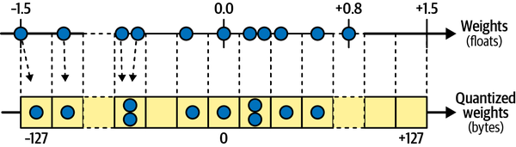
Quantization (Géron, Figure 19-5). Useful when deploying a model to an embedded or mobile device (TFLite).

Slide 19
C. GPU
GPUs (Graphics Processing Units) can significantly speed up computation by leveraging their architecture, which is optimized for parallel processing.
Unlike CPUs (Central Processing Units), which are designed for sequential serial processing and have a few cores optimized for single-threaded performance, GPUs consist of thousands of smaller, more efficient cores designed to handle multiple tasks simultaneously. This architecture makes GPUs exceptionally well-suited for computational tasks that can be parallelized.

Slide 20
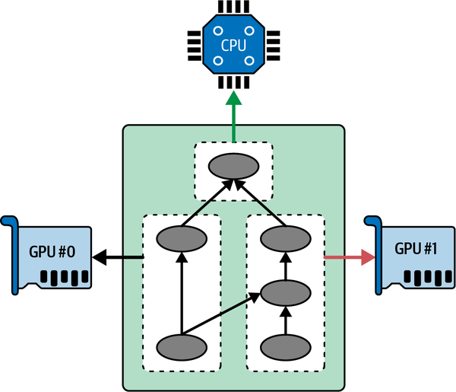
Executing a Tensorflow graph across multiple devices in parallel (Géron, Figure 19-6)

Slide 21
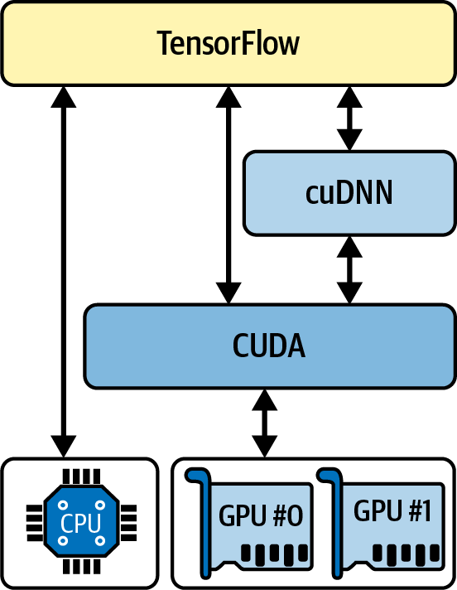
Tensorflow using CUDA and cuDNN to control GPUs. (Géron, Figure 19-7)

Slide 22
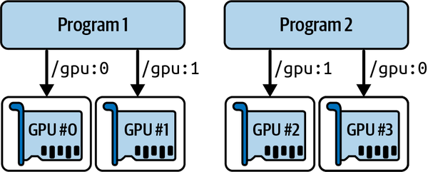
Each program gets two GPUs. (Géron, Figure 19-8)

Slide 23
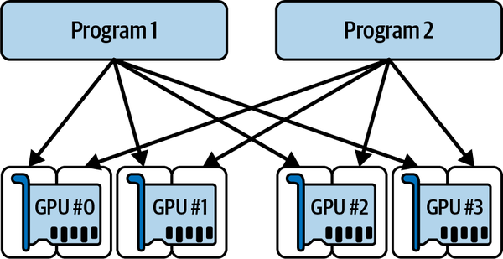
Each program gets all four GPUs, but only 2 GB of RAM on each GPU. (Géron, Figure 19-9)

Slide 24
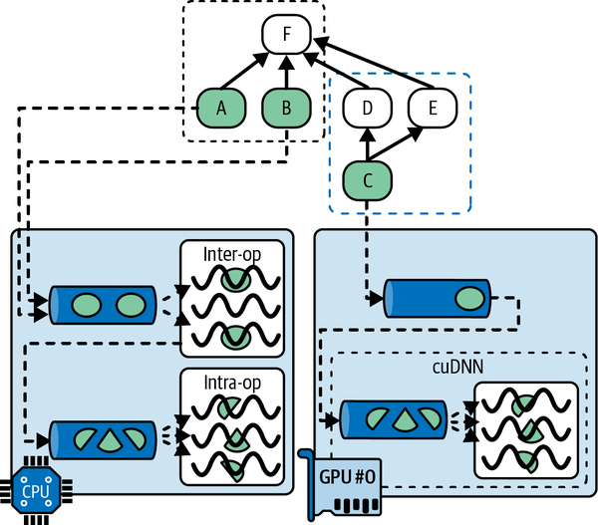
Parallel execution across multiple devices. (Géron, Figure 19-10)

Slide 25
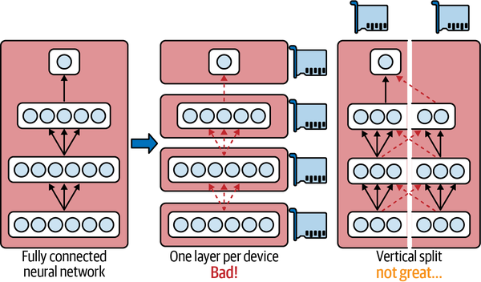
Splitting a fully connected neural network. (Géron, Figure 19-11)

Slide 26
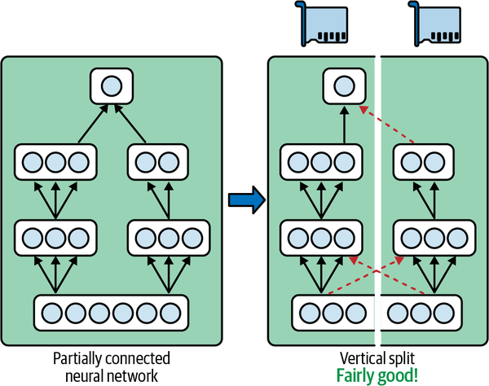
Splitting a partially connected neural network. (Géron, Figure 19-12)

Slide 27
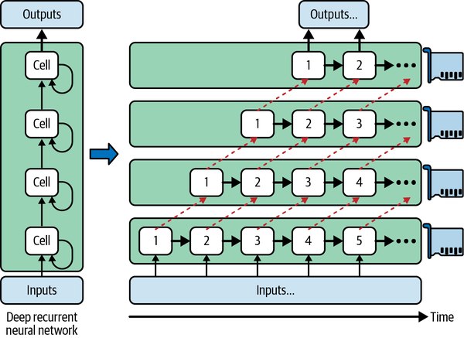
Splitting a deep recurrent neural network. (Géron, Figure 19-13)

Slide 28
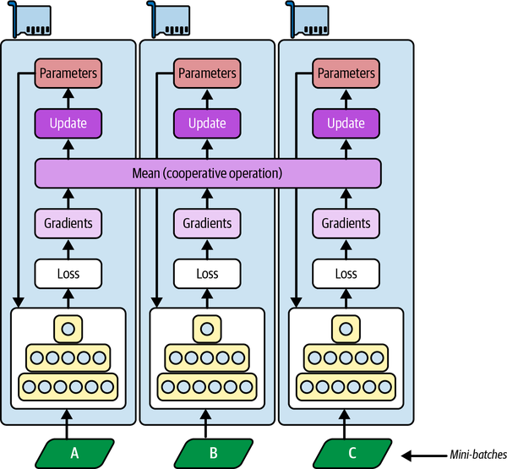
Data parallelism using a mirrored strategy. (Figure 19-14)

Slide 29
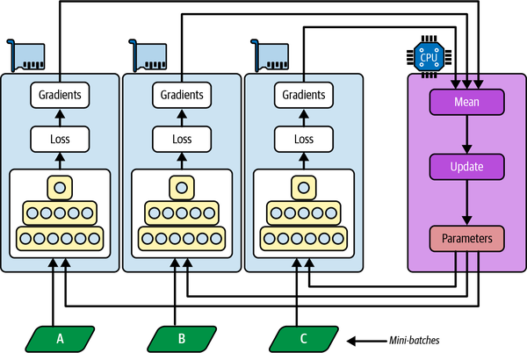
Data parallelism using centralized parameters. (Géron, Figure 19-15)

Slide 30

PipeDream’s pipeline parallelism. (Géron, Figure 19-17)

Slide 31
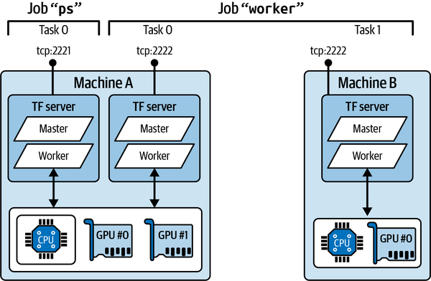
An example Tensorflow cluster. (Géron, Figure 19-18)

Slide 32
D. Other Vertex AI Considerations
Running Large Training Jobs on Vertex AI – using many GPUs and servers to train a very large model may be more efficiently conducted on the Google Cloud Service (Vertex AI).
Hyperparameter Tuning on Vertex AI – based on a Bayesian optimization algorithm, it can find the optimal combination of hyperparameters quickly.

Slide 33
D. Final Thoughts on the Book
The book covered many topics well, some of which I found more readily applicable.
Sometimes the details in the book did not seem necessary to explain the concepts or principles.
The book focuses on the Tensorflow/Keras libraries.
The second half of the book is quickly becoming dated.
Overall, a very good introductory text on machine learning.

